Slide 1
Application Programmer
OpenGL API
OpenGL
HW1
HW2
HW3
HW4

Slide 2
OpenGL Rendering Pipeline
1. Vertex Processing:
Each vertex in the vertex array is processed in turn into an output vertex .
It then goes through tessellation stages and geometry shader primitive processing for producing a sequence of primitives.
2. Vertex Post-Processing:
Outputs of the last stage are adjusted or shipped to different locations.
Transform Feedback happens here like Primitive Assembly, Primitive Clipping, the perspective divide, and the viewport transform to window space.
3. Scan conversion and primitive parameter interpolation, which
generates a number of Fragments.
4. A Fragment Shader processes each fragment. Each fragment generates a
number of outputs.
5. Per-Sample Processing:
Scissor Test, Stencil Test, Depth Test, Blending, Logical Operation, Write Mask

Slide 3
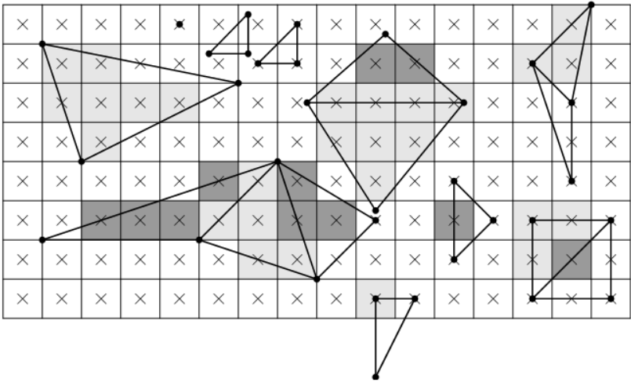
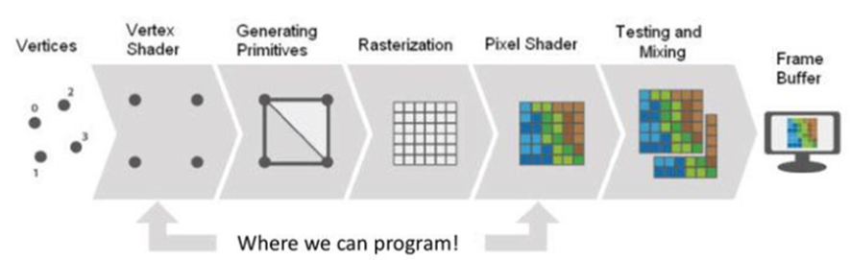
Rasterization (Scan Conversion)
It is a process that determines which pixels that are inside primitive specified by a set of vertices
It produces a set of fragments that have a pixel location and other attributes like colour, texture

Slide 4
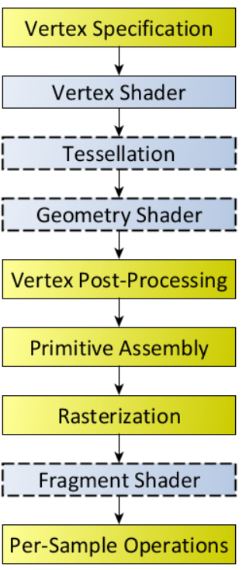

Slide 5
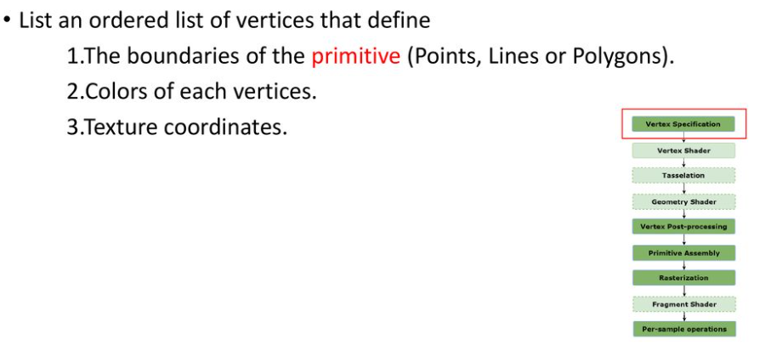
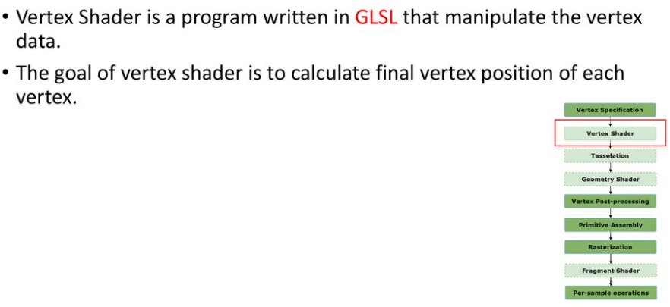

Slide 6
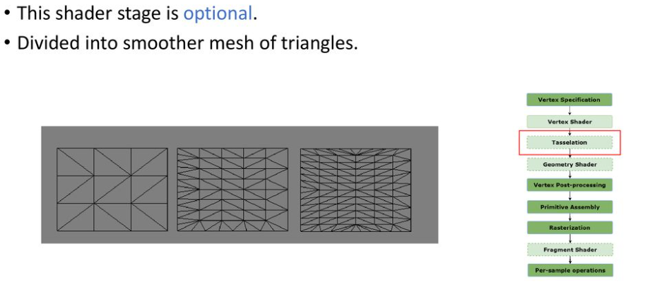
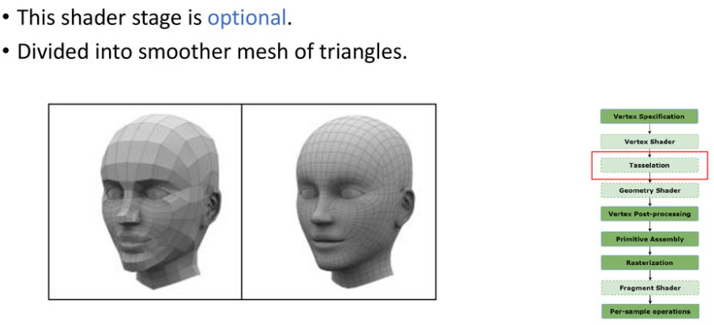

Slide 7
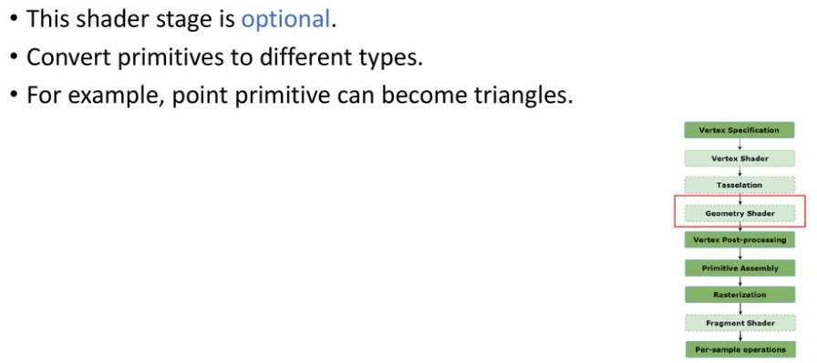
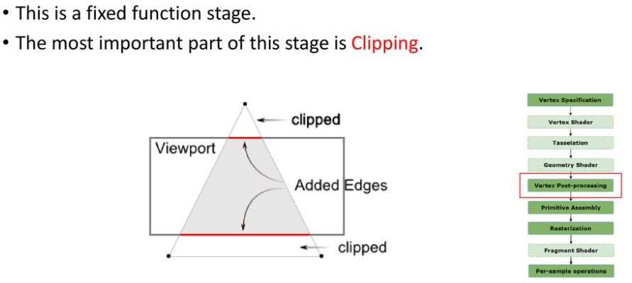

Slide 8
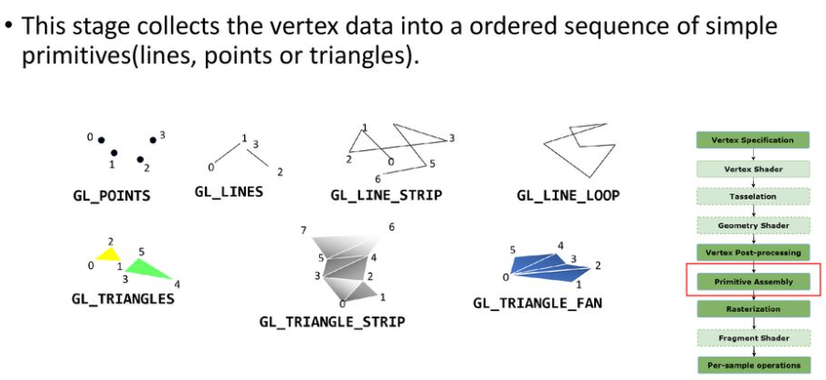
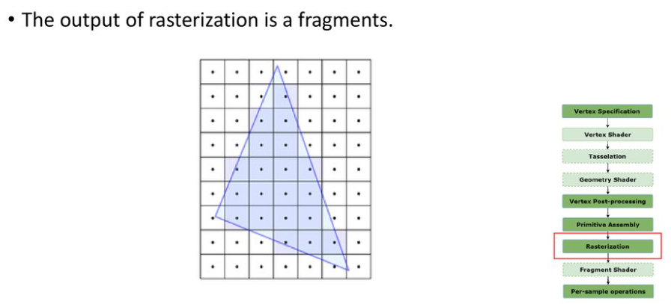

Slide 9
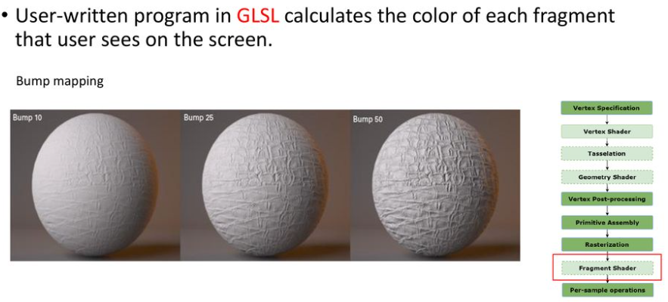
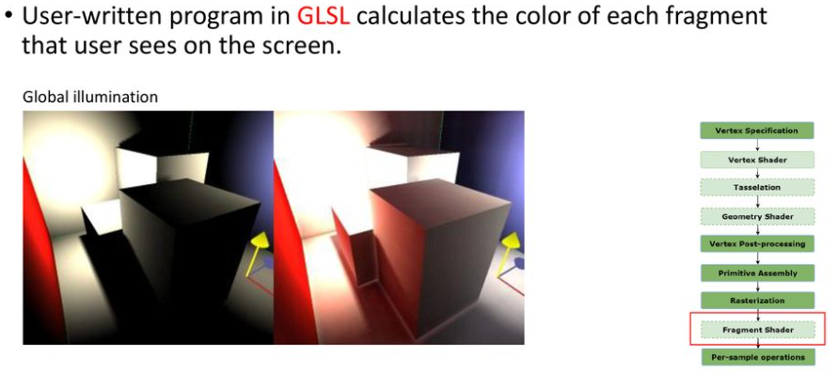

Slide 10
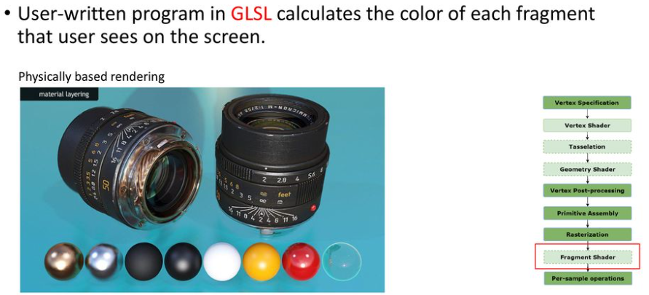

Slide 11
OPENGL
An operating system and hardware platform independent graphics library designed to be easily portable yet rapidly executable.
It brings a standard 3D graphics library with the hardware enhanced ability to perform lighting , shading, texture mapping, hidden surface removal and animation on to the windows platform
Open GL is available on a variety of hardware platforms and operating systems.
OpenGL was written with the express intention of becoming a thin software interface to underlying graphics hardware an arrangement of proven success in the graphics workstation market.

Slide 12
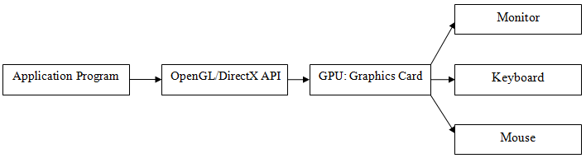
OPENGL

Slide 13
OPENGL
A software interface to graphics hardware
About 250 distinct commands
200 in core OpenGL and 50 in OpenGL Utility Library to produce interactive 3D applications
Designed as hardware independent interface to be implemented on different hardware platforms
To achieve these no windowing tasks or obtaining user inputs are included in open GL
Desired models are built up from a small set of geometric primitives – points, lines, polygons

Slide 14
Features of Open GL:
Texture Mapping :
The ability to apply an image to a graphics surface, this technique is used to rapidly generate realistic images without having to specify on excessive amount of detail regarding pixel coordinates, textures etc
Z-Buffering:
The ability to calculate the distance from the viewer’s location. this makes it easy for the program to automatically remove surface or parts of surfaces that are hidden from view
Double Buffering:
Support for smooth animation using double buffering. A smooth animation sequence is achieved by drawing into the back buffer while displaying the front buffer and then swapping the buffers when ready to display the next animation sequence
Lighting Effects:
The ability to calculate the effects on the lightness of a surface’s color when different lighting models are applied to the surface from one or more light sources

Slide 15
Features of Open GL:
Smooth Shading:
The ability to calculate the shading effect that occurs when light hits a surface at an angle and results in subtle color differences across the surface. This effect is important for making model look realistic
Material Properties:
The ability to specify the material properties of a surface. These properties modify the lighting effects on the surface by specifying such this as dullness or shininess of the surface
Alpha Blending:
The ability to specify alpha or opacity value in addition to the regular red , green, blue values. The alpha component is used to specify opacity, allowing the full range from completely transparent to totally opaque. When used in combination with z buffer, Alpha blending gives the effect of being able to see through objects

Slide 16
Developer’s Advantage:
Industry Standard:
the Open GL architecture Review board an independent consortium guides the Open GL specification Open GL is the only true open vendor-neutral, multiplatform graphics standard with a broad industry support
Stability:
Updating to Open GL specification are carefully controlled and updates are announced in time for developers to adopt changes. Backward compatibility requirements ensure the viability of existing applications
Portability:
applications produce consistent visual display result on any OpenGL API compliant hardware regardless of OS or windowing system. So once a program is written for any platform, it can be ported for other platforms as well.

Slide 17
Developer’s Advantage:
Evolving:
New hardware innovations are accessible thru the API via the OpenGL extension mechanism Innovations are phased in to enable developers and hardware vendors to incorporate new features into their product release cycles
Scalability:
Open GL applications can be scaled to any class of machine, everything from consumer electronics to PCS, workstations, Super Computers
Ease of Use:
Efficient OpenGL routines typically result in applications with fewer lines of code than programs created with other graphics libraries or packages. OpenGL driver encapsulates the information about the underlying hardware so the application programmer does not need to b e concerned about having to design for specific hardware features

Slide 18
History
OpenGL was first created as an open and reproducible alternative to Iris GL which had been the proprietary graphics API on Silicon Graphics workstations.
Although OpenGL was initially similar in some respects to IrisGL the lack of a formal specification and conformance tests made Iris GL unsuitable for broader adoption.
Mark Segal and Kurt Akeley authored the OpenGL 1.0 specification which tried to formalize the definition of a useful graphics API and made cross platform non-SGI 3rd party implementation and support viable.
One notable omission from version 1.0 of the API was texture objects.
IrisGL had definition and bind stages for all sorts of objects including materials, lights, textures and texture environments. OpenGL avoided these objects in favor of incremental state changes with the idea that collective changes could be encapsulated in display lists. This has remained the philosophy with the exception that texture objects (glBindTexture) with no distinct definition stage are a key part of the API.

Slide 19
History
OpenGL has been through a number of revisions which have predominantly been incremental additions where extensions to the core API have gradually been incorporated into the main body of the API.
OpenGL 1.1: added the glBindTexture extension to the core API.
OpenGL 2.0 : addition of the OpenGL Shading Language (also called GLSL), a C like language with which the transformation and fragment shading stages of the pipeline can be programmed.
OpenGL 3.0 : adds the concept of deprecation: marking certain features as subject to removal in later versions. GL 3.1 removed most deprecated features, and GL 3.2 created the notion of core and compatibility OpenGL contexts.
Official versions of OpenGL released to date are 1.0, 1.1, 1.2, 1.2.1, 1.3, 1.4, 1.5, 2.0, 2.1, 3.0, 3.1, 3.2, 3.3, 4.0, 4.1, 4.2, 4.3, 4.4, 4.5.

Slide 20
Model-View-Controller Architecture
Interactive program design involves breaking the program into three parts:
The Model: all the data that are unique to the program reside there. This might be game state, the contents of a text file, or tables in a database.
The View of the Model: it is a way of displaying some or all of the data to user. Objects in the game state might be drawn in 3D, text in the file might be drawn to the screen with formatting, or queries on the database might be wrapped in HTML and sent to a web browser.
The Controller: the methods for user to manipulate the model or the view. Mouse and keystrokes might change the game state, select text, or fill in and submit a form for a new query.

Slide 21
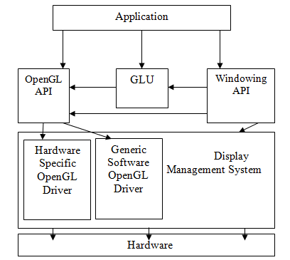
Architecture

Slide 22
OPENGL
OpenGL Utility Toolkit (GLUT)
provides several routines for opening windows detecting input and creating complicated 3D objects like spehere , torus , teapot
OpenGL Utility Library (GLU)
Contains several routines that use lower level OpenGL Commands to perform tasks as setting up matrices, for specific viewing orientations and projections etc. e.g.
GL
Core Open GL APIs

Slide 23
OPENGL
#include <necessary header files>
main(){
InitializeWindow();
Rendering operations(); UpdateWindowAndCheckForEvents();
}

Slide 24
OpenGL Command Syntax
Uses the prefix gl and initial capital letters for each word making up the command name
e.g. glClearColor(---------);
glVertex3f(---------);
Constants begin with GL
Use all capital letters and underscores to separate words e.g. GL_COLOR_BUFFER_BIT

Slide 25
Data types
Data type Corresponding C language OpenGL TypeDefinition
8 bit integer signed char GLbyte
16 bit integer short GLshort
32 bit integer int or long GLint, GLsizei
32 bit float float GLfloat
64 bit float double GLdouble

Slide 26
GL Related Libraries
OpenGL Utility Library (GLU):
Contains several routines that use lower level OpenGL Commands to perform tasks as setting up matrices, for specific viewing orientations and projections etc. e.g.
gluPerspective(…………..);

Slide 27
OPENGL
OpenGL Utility Toolkit (GLUT): A window system independent toolkit written by Mark Kilgard to hide the complexities of differing system APIs
OpenGL contains only rendering commands and no commands for opening windows or reading events from keyboard or mouse

Slide 28
OPENGL
GLUT provides several routines for opening windows detecting input and creating complicated 3D objects like spehere , torus , teapot
GLUT routines use the prefix glut
e.g. glutCreateWindow(…);
glutInit(…);
glutMouseFunc(…..); glutKeyboardFunc(…..);

Slide 29
Windows Management
Five routines perform tasks necessary for initializing a window
glutInit(int *argc, char **argv)
Initializes glut and processes command line arguments
glutInit();
- should be called before any other GLUT routine
glutInitDisplayMode(unsigned int mode)
specifies whether to use an RGBA or color-index model
specifies whether to use a single or double buffered window and specify a depth buffer
glutInitDisplayMode(GLUT_SINGLE|GLUT_RGBA|GLUT_DEPTH);

Slide 30
OPENGL
glutInitWindowPosition(int x, int y)
- specifies screen location for the upper loft corner of your window
glutInitWindowSize(int x, int y)
- specifies the size in pixels of your window
glutCreateWindow(char *string)
- creates a window with the name that you supplies as the string (pointer) variable

Slide 31
Callback Functions
A function passed as an argument to another function

Slide 32
The Display Callback
glutDisplayFunc(void (*func)(void))
- most important event callback function
- Whenever GLUT determines that the contents of the window need to be redisplayed the call back function registered by glutDisplayFunc() is executed
- All the routines needed to redraw the scene are placed here

Slide 33
OPENGL
glutMainLoop()
- This is an infinite loop
- All the windows that have been created are now shown infinitely

Slide 34
Setting up 2D Projection
void myReshape(int w, int h) { // window is reshaped
glViewport (0, 0, w, h); // update the viewport
glMatrixMode(GL_PROJECTION); // update projection
glLoadIdentity();
gluOrtho2D(0.0, 1.0, 0.0, 1.0); // map unit square to viewport
glMatrixMode(GL_MODELVIEW);
glutPostRedisplay(); // request redisplay
}

Slide 35
Handling input events
Use the following routines to register callback commands that are invoked when specified events occur
glutReshapeFunc(void (*func)(int w, int h))
- Indicates what action should be taken when the window is resized
glutKeyboardFunc(void (*func)(unsigned char key, int x, int y))
glutMouseFunc(void (*func)(int button, int state, int x, int y))
- Allow you to link a keyboard key or a mouse button with a routine that’s invoked when the key or mouse button is pressed or released

Slide 36
Managing a background process
glutIdleFunc((*func)(void))
- Used to specify a function that’s to be executed if no other events are pending
- This routine takes a pointer to a function as its only argument

Slide 37
OPENGL
#include <windows.h>
#include <gl/glut.h>
#include <gl/glu.h>
void main(int argc, char **argv){
glutInit(&argc,argv);
glutInitDisplayMode(GLUT_SINGLE|GLUT_RGB);
glutInitWindowPosition(100,100);
glutInitWindowSize(100,100);
glutCreateWindow(“Open GL Lab Work");
glutDisplayFunc(display);
glutMainLoop();
}

Slide 38
OPENGL
#include <windows.h>
#include <gl/glut.h>
#include <gl/glu.h>
//CLEARING THE BACKGROUND
void display(){
glClearColor(1.0,0.0,1.0,1.0);
glClear(GL_COLOR_BUFFER_BIT);
glFlush();
}
void main(int argc, char **argv){
glutInit(&argc,argv);
glutInitDisplayMode(GLUT_SINGLE|GLUT_RGB);
glutInitWindowPosition(100,100);
glutInitWindowSize(100,100);
glutCreateWindow(“Open GL Lab Work");
glutDisplayFunc(display);
glutMainLoop();
}

Slide 39
PLOTTING A POLYGON:
ADDED INSIDE DISPLAY FUNCTION
glShadeModel(GL_SMOOTH);
glBegin(GL_POLYGON);
glVertex3f(0.25, 0.25, 0.0);
glVertex3f(0.75, 0.25, 0.0);
glVertex3f(0.75, 0.75, 0.0);
glVertex3f(0.25, 0.75, 0.0);
glEnd();

Slide 40
OPENGL
// TO SPECIFY FILL COLOR
//ADDED INSIDE DISPLAY FUNCTION
glClearColor(1.0,0.0,1.0,1.0);
glClear(GL_COLOR_BUFFER_BIT);
glShadeModel(GL_FLAT);
glColor3f(0.0,1.0,0.0);

Slide 41
Getting input from a Mouse
GLfloat x = 0.15;
void display(){
glClearColor(1.0,1.0,1.0,1.0);
glClear(GL_COLOR_BUFFER_BIT);
glColor3f(0.0,0.0,1.0);
glBegin(GL_POLYGON);
glVertex3f(0.25+x,0.25,0.0);
glVertex3f(0.75+x,0.25,0.0);
glVertex3f(0.75+x,0.75,0.0);
glEnd();
glFlush();
}
void trans(){
x = x - 0.001;
glutPostRedisplay();
}
void mouse(int button, int state, int x, int y){
switch(button){
case GLUT_LEFT_BUTTON:
if (state == GLUT_DOWN)
glutIdleFunc(trans);
break;
case GLUT_RIGHT_BUTTON:
if (state == GLUT_DOWN)
glutIdleFunc(NULL);
break;
}
}
void main(int argc, char **argv){
glutInit(&argc,argv);
glutInitDisplayMode(GLUT_SINGLE|GLUT_RGB);
glutInitWindowPosition(111,111);
glutInitWindowSize(200,100);
glutCreateWindow("saroj");
glutDisplayFunc(display);
glutMouseFunc(mouse);
glutMainLoop();
}

Slide 42
OPENGL
void reshape(int w, int h){
glViewport(0,0,w,h);
glMatrixMode(GL_PROJECTION);
glLoadIdentity();
glOrtho(0,50,0,50,-1,1);
//glOrtho(left,right,bottom,top,near,far);
glMatrixMode(GL_MODELVIEW);
glLoadIdentity();
}
void main(int argc, char **argv){
glutInit(&argc,argv);
glutInitDisplayMode(GLUT_SINGLE|GLUT_RGB);
glutInitWindowPosition(200,200);
glutInitWindowSize(200,200);
glutCreateWindow("Triangle");
glutDisplayFunc(display);
glutReshapeFunc(reshape);
glutMainLoop();
}
GL_PROJECTION : Applies subsequent matrix operations to the projection matrix stack.
GL_MODELVIEW : Applies subsequent matrix operations to the modelview matrix stack.

Slide 43
OPENGL
glutPostRedisplay();
— marks the current or specified window as needing to be redisplayed.

Slide 44
Transformations
Translation: glTranslate*(tx, ty, tx)
Here tx, ty, tx are the translation factors, the suffix * may be a f (float) or d (double)
Rotation: glRotate(theta, vx, vy, vz)
Here vx, vy and vz are orientation for a rotation axis that passes through the coordinate origin
theta is the rotation angle in degrees
Scale: glScale*(sx, sy, sz)
Here sx, sy and sz are scaling factors

Slide 45
OPENGL
void gluLookAt( GLdouble eyex, GLdouble eyey, GLdouble eyez, GLdouble centerx, GLdouble centery, GLdouble centerz, GLdouble upx, GLdouble upy, GLdouble upz );
Parameters
eyex, eyey, eyez The position of the eye point.
centerx, centery, centerz The position of the reference point.
upx, upy, upz The direction of the up vector.
The gluLookAt function creates a viewing matrix derived from an eye point, a reference point indicating the center of the scene, and an up vector.

Slide 46
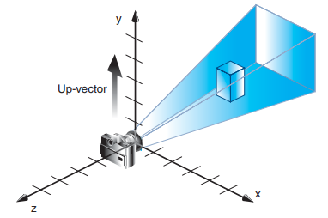
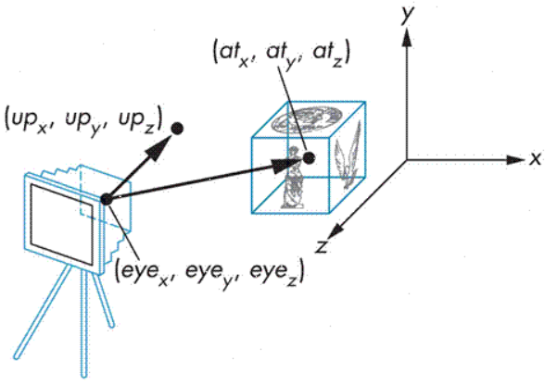
OPENGL
void gluLookAt( GLdouble eyex, GLdouble eyey, GLdouble eyez,
GLdouble centerx, GLdouble centery, GLdouble centerz,
GLdouble upx, GLdouble upy, GLdouble upz );
where the camera (or eye position) is placed
where it is aimed
which way is up

Slide 47
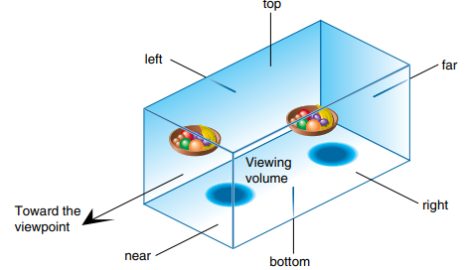
OPENGL
void glOrtho(GLdouble left, GLdouble right, GLdouble bottom, GLdouble top, GLdouble near, GLdouble far);
Creates a matrix for an orthographic parallel viewing volume and multiplies the current matrix by it.
(left, bottom, –near) and (right, top, –near) are points on the near clipping plane that are mapped to the lower left and upper right corners of the viewport window, respectively.
(left, bottom, –far) and (right, top, –far) are points on the far clipping plane that are mapped to the same respective corners of the viewport.
Both near and far may be positive, negative, or even set to zero. Near and far should not be the same value.

Slide 48
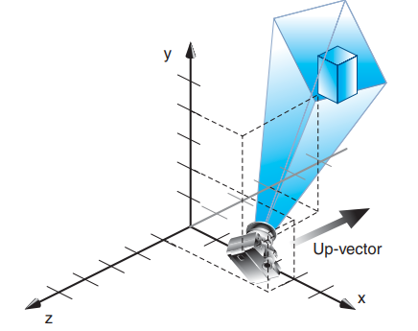
gluLookAt(4.0, 2.0, 1.0, 2.0, 4.0, -3.0, 2.0, 2.0, -1.0)
The camera position (eyex, eyey, eyez) is at (4, 2, 1).
The camera is looking right at the model, so the reference point is at (2, 4, –3).
An orientation vector of (2, 2, –1) is chosen to rotate the viewpoint to this 45-degree angle

Slide 49
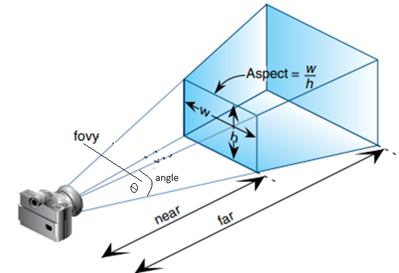
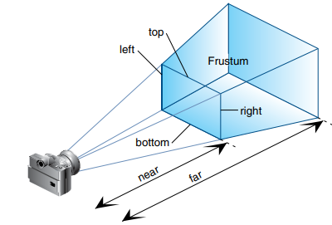
OPENGL
void gluPerspective(GLdouble fovy, GLdouble aspect, GLdouble near, GLdouble far);
Creates a matrix for a symmetric perspective-view frustum and multiplies the current matrix by it.
fovy is the angle of the field of view in the yz-plane; its value must be in the range [0.0, 180.0].
aspect is the aspect ratio of the frustum, its width divided by its height.
near and far values are the distances between the viewpoint and the clipping planes, along the negative z-axis.
They should always be positive.

Slide 50
Light
glLightfv(GL_LIGHT0,GL_POSITION,position):
Set light-source parameters.
void glLightfv( GLenum light, GLenum pname, const GLfloat *params);
light
The identifier of a light
GL_LIGHTi where 0 ≤ i < GL_MAX_LIGHTS
At least eight lights are supported.
pname
A single-valued light-source parameter for light position
param
The value to which parameter pname of light source
light will be set.
Notes:
X,Y,X,W IF W IS 0 DIRECTIONAL ELSE POSITIONAL LIGHT SOURCE

Slide 51
Lighting
glMaterial*() affect the colors of the diffuse, specular and ambient light reflected by an object
gLfloat mat_specular[] = {1,0,0,1};
glMaterialfv(GL_FRONT, GL_SPECULAR, mat_specular);
glEnable(GL_LIGHTING);
glEnable(GL_LIGHT0);
glEnable(GL_DEPTH_TEST);
glutSolidSphere(1.0, 20, 16);
glFlush();

